Slide 1

Practical Aspects of Beamformers in Pediatric Epilepsy
Jeffrey Tenney, MD, PhD
Associate Professor of Pediatrics, Neurology, and Neuroscience
Clinical Director, Magnetoencephalography Laboratory
Cincinnati Children’s Hospital Medical Center
University of Cincinnati School of Medicine

Slide 2
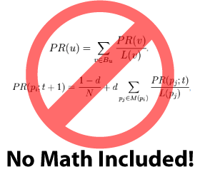
Outline
What is beamforming?
Advantages and disadvantages
Beamformers and clinical epilepsy
  Review of literature
  Clinical examples
The future of beamformers
https://independentseminarblog.com/author/maxydu/

Slide 3
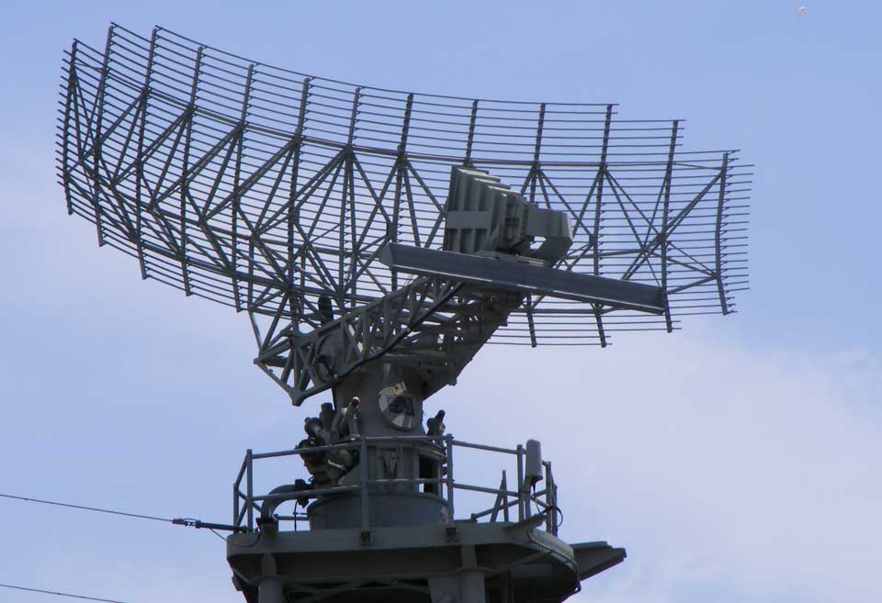
What is beamforming?
https://www.thecroforum.org/risk-radar/
Beamformers are spatial filters.
A spatial filter is a weighted output of MEG sensors that reflects activity at a specific location.
Initially developed for radar applications.
Attenuates sources of spatially correlated noise.
Main assumption
  Two distant cortical areas do not generate coherent local field potentials over long time scales.
The output of the filter over time is a “virtual sensor”.
Creating a lattice of spatial filters throughout the brain allows a “source image”.

Slide 4
What is beamforming?
R
T

Slide 5
What is beamforming?
R
T
I

Slide 6
What is beamforming?
R
T
R
R
R
+
+
I

Slide 7
What is beamforming?
Beamformer algorithms differ by forward model
  Vector beamformers
    Orthogonal current sources at each voxel
    Linearly Constrained Minimum Variance (LCMV) beamformer
  Scalar beamformers
    Optimal current direction at each voxel
    Synthetic aperture magnetometry (SAM)

Slide 8
What is beamforming?
Many variations of beamformers exist
  Linearly Constrained Minimum Variance (LCMV) beamformer
  Synthetic Aperture Magnetometry (SAM)
  Eigenspace beamformer
  Dynamic Imaging of Coherent Sources (DICS)
  Event-related SAM (erSAM)
  SAMerf
  5-D beamformer
  Event-related beamformer (ERB)

Slide 9
Advantages
Does not require an average-evoked response.
Relatively little user interaction.
  number of sources not defined a priori
Can be computed sequentially for all voxels in a pre-defined source space.

Slide 10
Disadvantages
Fails with highly correlated distant sources
  Auditory stimulus
    Sub-selection of sensors?
  Does epilepsy result in a “highly correlated” state?

Slide 11
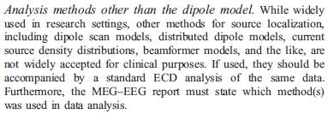
Beamformers and Clinical Epilepsy
ACMEGS Clinical Practice Guideline. (Bagic et al 2011)

Slide 12
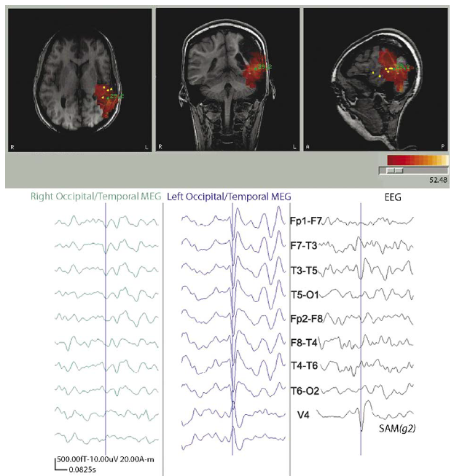
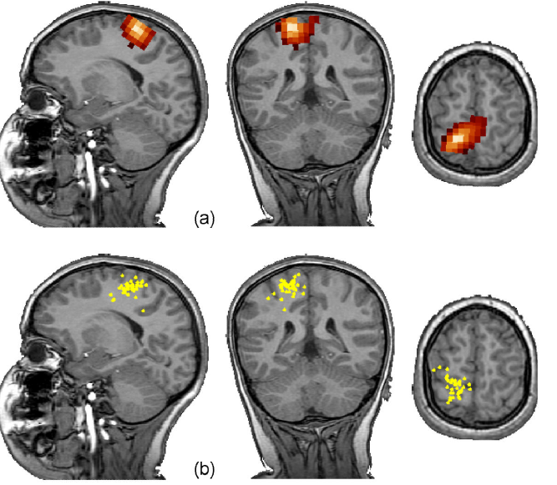
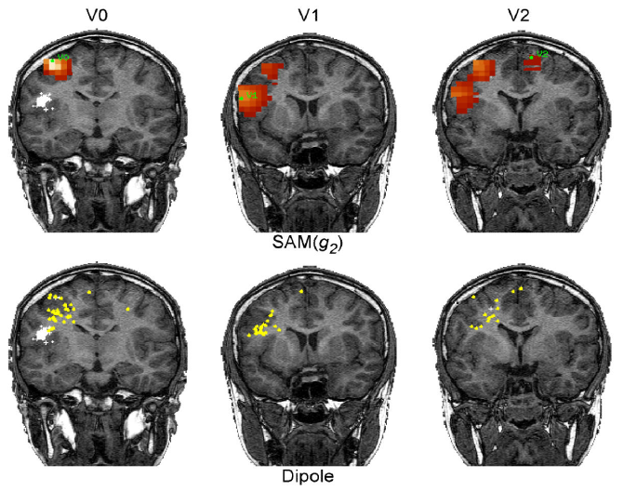
Beamformers and Clinical Epilepsy
SAM(g₂) is equivalent to ECD for localizing spikes with a single locus and good SNR. (Robinson et al 2004, Kirsch et al 2006)

Slide 13
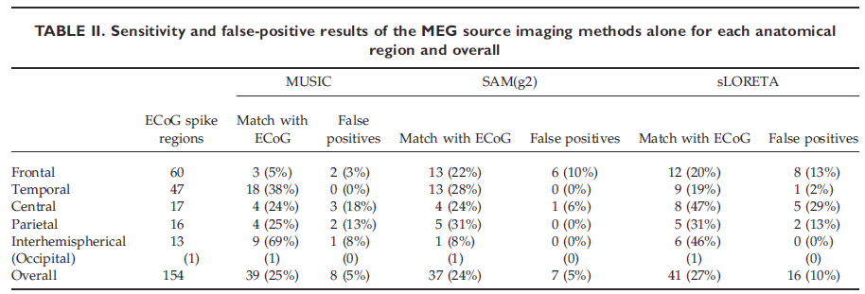
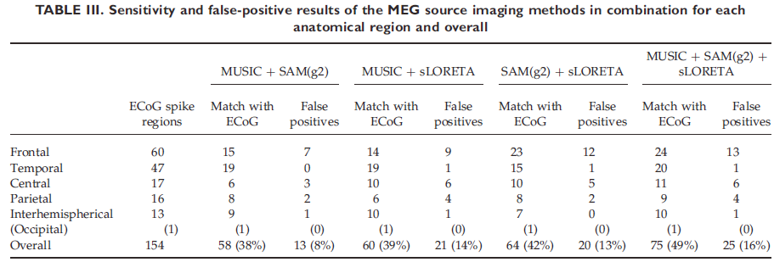
Beamformers and Clinical Epilepsy
MUSIC, SAM(g₂), and sLORETA have similar correlation with ECoG spikes.
Sensitivity varies with brain region.
Best results were found with MUSIC + SAM(g₂).
Concordance with ECoG doubles when models are combined.
Recommended to use two complimentary methods. (de Gooijer-van de Groep et al, 2012)

Slide 14
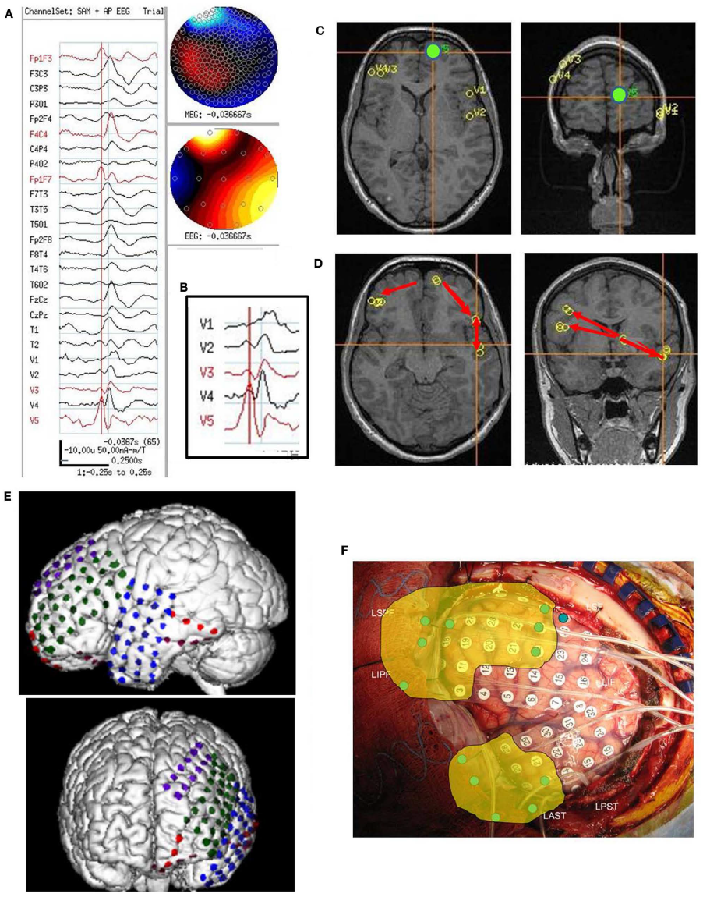
Beamformers and Clinical Epilepsy
Beamformer analysis may distinguish subregions of spiking based on timing of virtual sensor waveforms.
Differences in timing may be seen by visual inspection and may reveal networks of spread.(Rose et al, 2013)

Slide 15
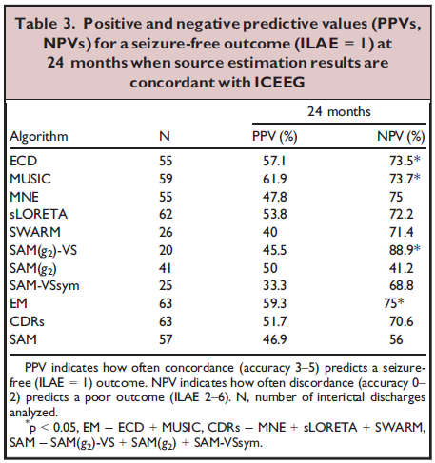
Beamformers and Clinical Epilepsy
ECD dipole/scanning, current density reconstructions, and beamforming methods compared. (Tenney et al, 2014)
32 pediatric patients w/ iEEG, resective surgery, and clinical outcome at 24 mo.
SAM(g₂) most accurate but no significant differences between methods.
PPV highest for ECD (57%) and MUSIC (62%).
NPV highest for SAM(g₂)-VS (83%).

Slide 16
Beamformers and Clinical Epilepsy
Clinical Case
16mo F w/ TSC-1
Semiology: Behavioral arrest, tonic stiffening of left face, odd laugh, then bilateral extension of arms (Left often greater than Right), associated with repetitive head drops and trunk flexions (spasms). Longest seizure 30 seconds. Frequency: 8/day.
AEDs: TPM, VGB
Interictal EEG: RT and RP epileptiform discharges, RF/RT slowing
Ictal EEG: RT/RP sharply contoured rhythmic delta

Slide 17
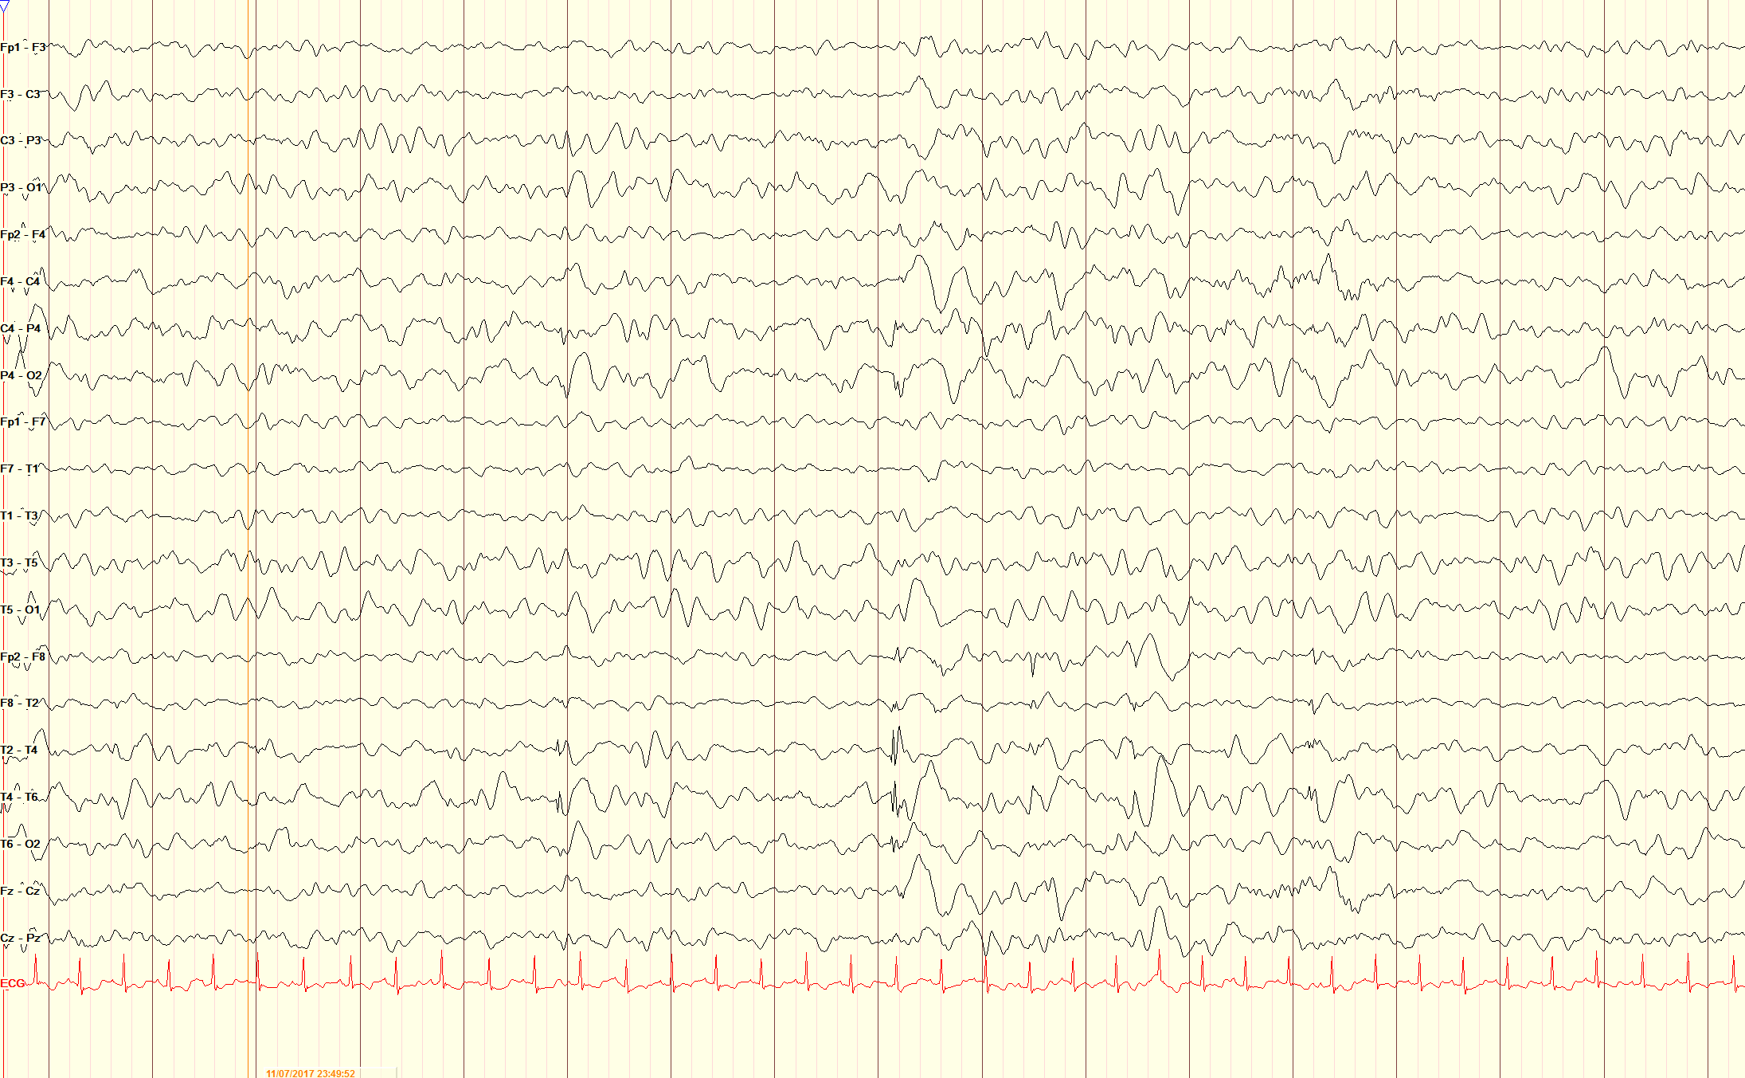
Beamformers and Clinical Epilepsy
Clinical Case

Slide 18
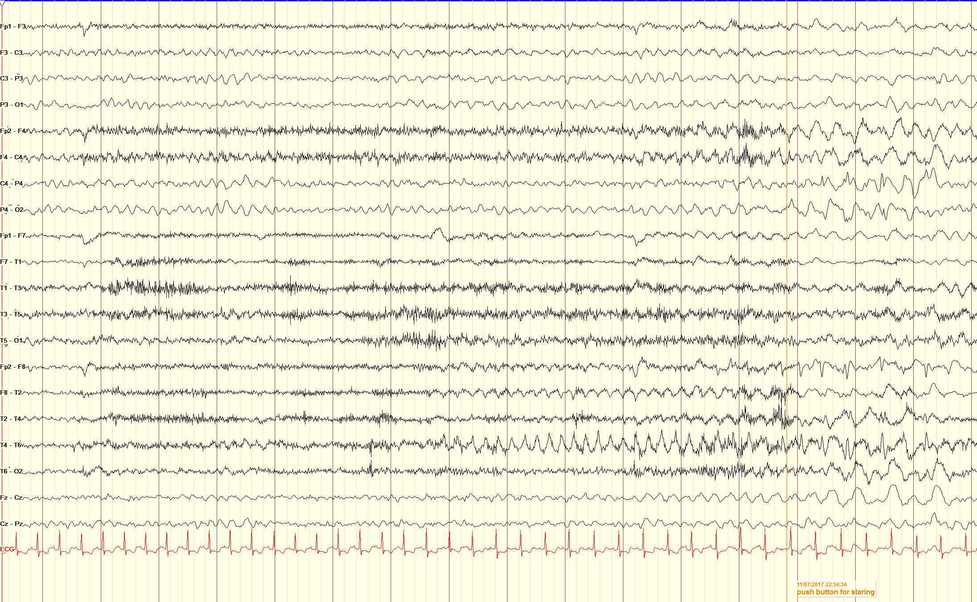
Beamformers and Clinical Epilepsy
Clinical Case

Slide 19
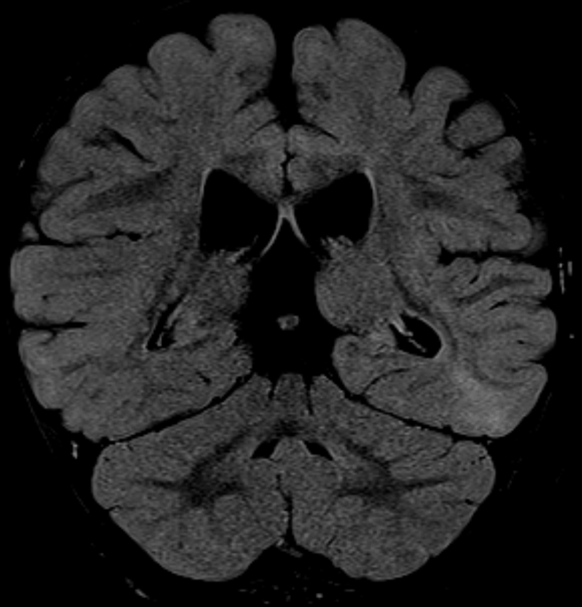
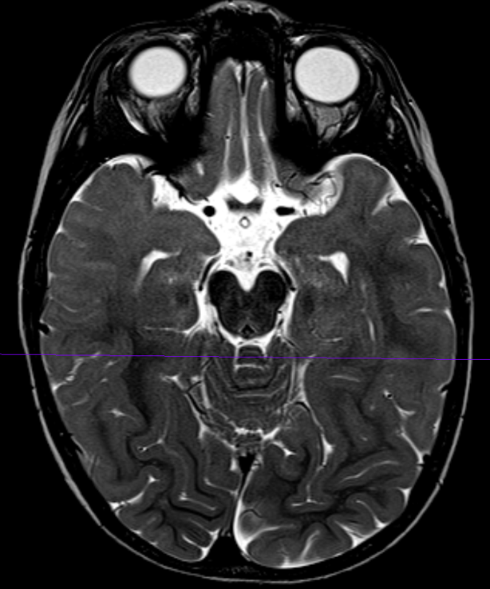
Beamformers and Clinical Epilepsy
Clinical Case
Multifocal tubers

Slide 20
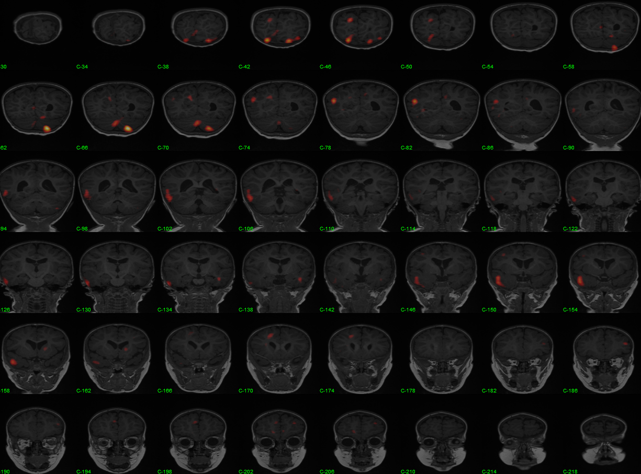
Beamformers and Clinical Epilepsy
Clinical Case
SISCOM - RT

Slide 21
Beamformers and Clinical Epilepsy
Clinical Case

Slide 22
Beamformers and Clinical Epilepsy
Clinical Case

Slide 23
Beamformers and Clinical Epilepsy
Clinical Case

Slide 24
Beamformers and Clinical Epilepsy
Clinical Case

Slide 25
Beamformers and Clinical Epilepsy
Clinical Case
Hypothesis: SOZ in peri-tuberal region of right temporal tuber
Right anterior temporal lobectomy w/ pre/post ECoG + hippocampal depth
  R anterior temporal and hippocampal spikes seen
Seizure free x 13 months

Slide 26
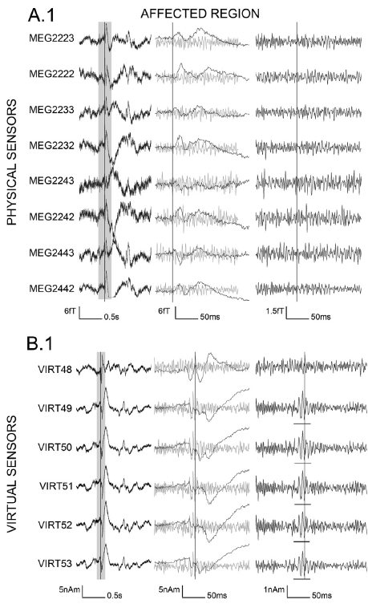
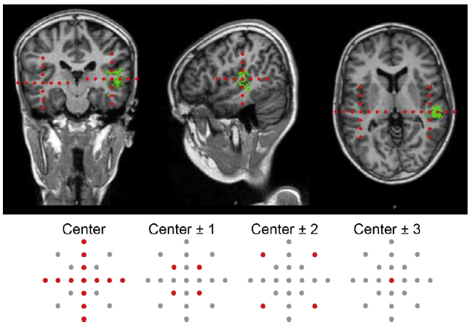
The Future of Beamformers
VS placed around epileptic spikes (based on ECD) and contralateral (unaffected) hemisphere.
VS and physical MEG sensors reviewed for HFOs.
Beamformer-based VS analysis may identify HFOs not seen in physical sensors (van Klink et al, 2016).

Slide 27
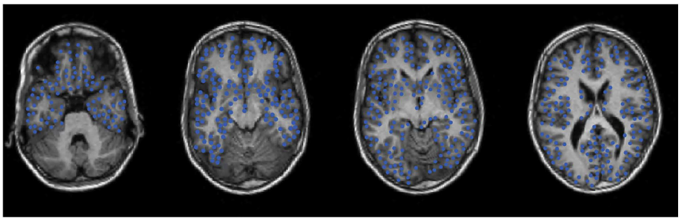
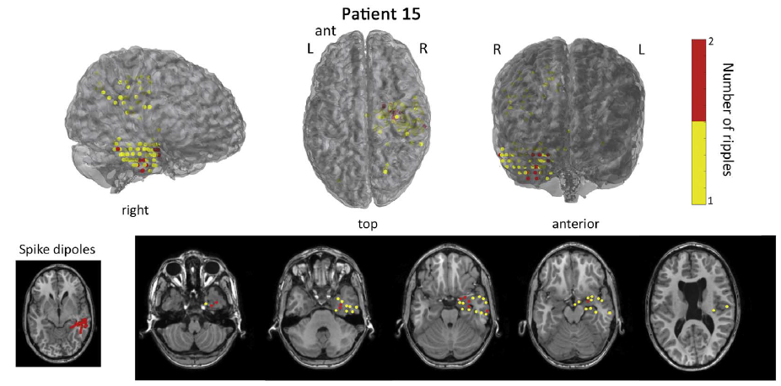
The Future of Beamformers
~2400 VS placed in symmetric GM.
Automatic ripple detection method.
Ripples identified in 16/25 patients, 14/16 with good/moderate concordance with MEG spikes.
6/8 patients with good concordance between ripple region and resection (van Klink et al, 2017).

Slide 28
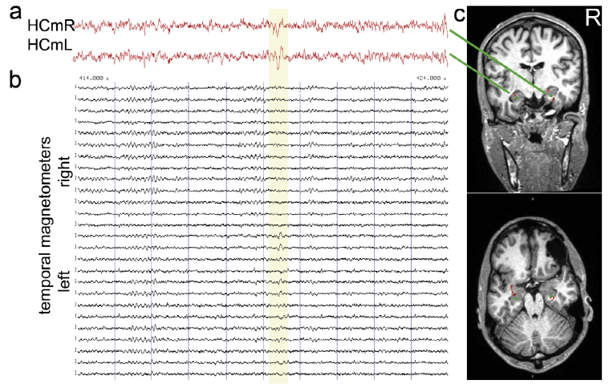

The Future of Beamformers
Two patients.
Construct VS waveforms from hippocampal regions.
Aids in identification of epileptiform activity not seen or missed on surface MEG review (Hillebrand et al, 2016).

Slide 29
The Future of Beamformers
11yo M w/ intractable non-lesional epilepsy
Occasional LT spikes on EEG/MEG

Slide 30
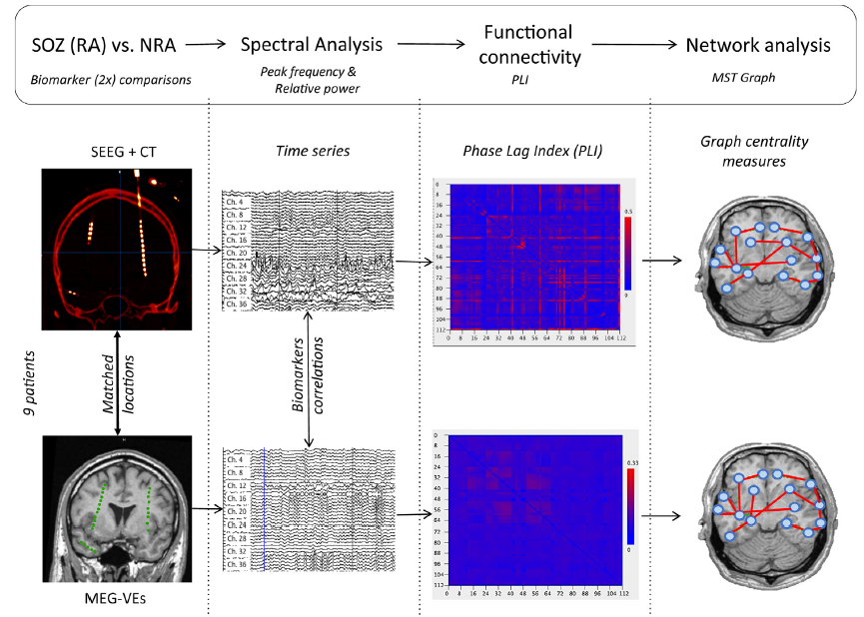
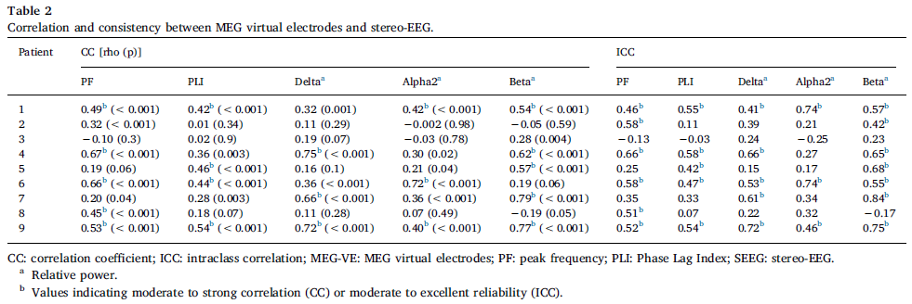
The Future of Beamformers
Is interictal activity at MEG-VS and sEEG comparable?
VS waveforms reconstructed at sEEG locations.
Spectral, connectivity, and network properties computed.
Suggests MEG-VS may be useful for sEEG planning (Juarez-Martinez et al, 2018).

Slide 31
The Future of Beamformers
Newly diagnosed CAE, comparing medication responders vs non-responders.
MEG-VS connectivity at pre-defined EEG-fMRI locations.
Frequency dependent connectivity patterns.
ETX non-responders with decreased degree in precuneus and increased degree in frontal cortex (Tenney et al, 2018).

Slide 32
Conclusions
Many beamformer methods exist with SAM having the most data to support its use for clinical epilepsy.
Can require less user assumptions than other source localization algorithms.
Beamformers may be complementary with conventional source analysis to better define the zone of irritability and provide targets for invasive monitoring.
In the future, beamformer techniques may help to more fully utilize the rich data captured during MEG recordings and bring network level analysis into the clinical domain.

Slide 33
References
Bagic AI, et al. American clinical magnetoencephalography society clinical practice guideline 1: Recording and Analysis of spontaneous cerebral activity. J Clin Neurophysiol. 2011;28:348-54.
De Gooijer-van de Groep, et al. Inverse modeling in magnetic source imaging: Comparison of MUSIC, SAM(g2), and sLORETA to interictal intracranial EEG. Hum Brain Mapp. 2013;34:2032-44
Hillebrand A, et al. Detecting epileptiform activity from deeper brain regions in spatially filtered MEG data. Clin Neurophysiol. 2016;127:2766-9.
Juarez-Martinez EL, et al. Virtual localization of the seizure onset zone: Using non-invasive MEG virtual electrodes at stereo-EEG electrode locations in refractory epilepsy patients. Neuroimage: Clinical. 2018;19:758-66.
Kirsch HE, et al. Automated localization of magnetoencephalographic interictal spikes by adaptive spatial filtering. Clin Neurophysiol. 2006;117:2264-71.
Robinson SE, et al. Localization of interictal spikes using SAM(g₂) and dipole fit. Neurol Clin Neurophysiol. 2004;74.
Rose DF, et al. Focal peak activities in spread of interictal-ictal discharges in epilepsy with beamformer MEG: evidence for an epileptic network? Front Neurol. 2013;4:1-17.
Tenney JR, et al. Comparison of magnetic source estimation to intracranial EEG, resection area, and seizure outcome. Epilepsia. 2014;55:1854-63.
Tenney JR, et al. Ictal connectivity in childhood absence epilepsy: Associations with outcome. Epilepsia. 2018;59:971-81.
van Klink, et al. Identification of epileptic high frequency oscillations in the time domain by using MEG beamformer-based virtual sensors. Clin Neurophysiol. 2016;127:197-208.
van Klink, et al. Automatic detection and visualisation of MEG ripple oscillations in epilepsy. Neuroimage: Clinical. 2017;15:689-701.
Vrba J and Robinson SE. Signal processing in magnetoencephalography. Methods. 2001;25:249-71.

